Slide 1
Introduction to biochemistry.
Structure and function of proteins
Lecturer: docent Girina Lyudmila Vladimirovna

Slide 2
Introduction of biochemistry
Biochemistry is the science concerned with studying the various molecules, chemical reactions, and processes that occur in living cells and organisms.
The major objective of biochemistry is the complete understanding at the molecular level of all of the chemical processes associated with living cells.

Slide 3
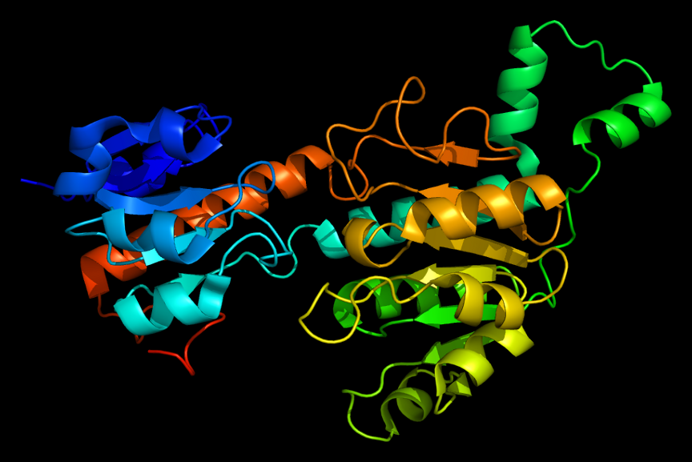
Proteins
Proteins are high-molecular nitrogen-containing compounds, consisting of alpha amino acid residues, connected by peptide bonds and performing various biological functions in the organism.

Slide 4
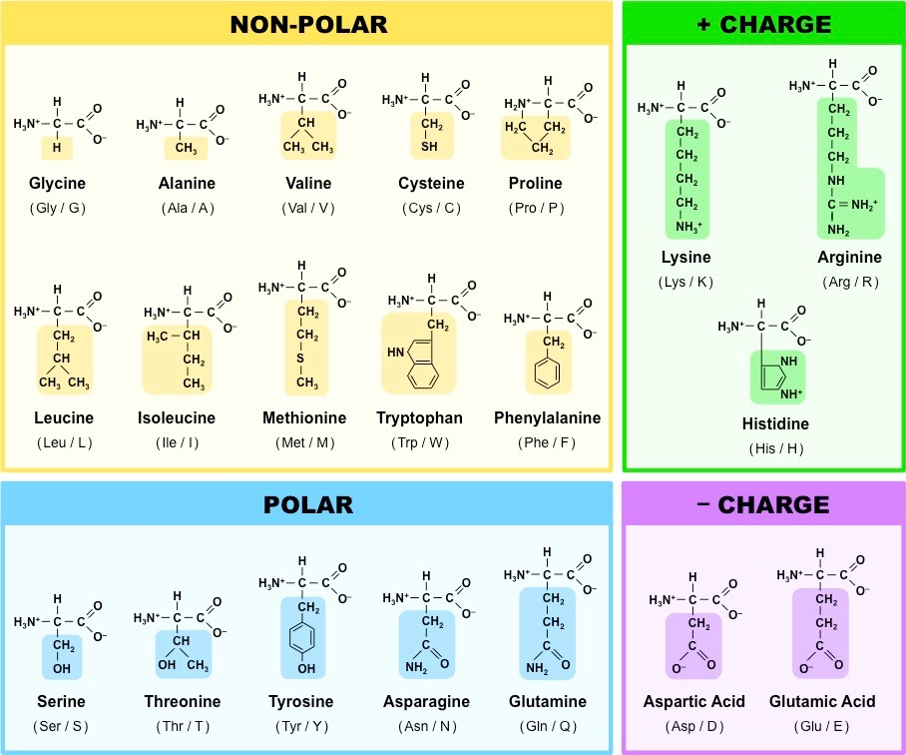

Slide 5
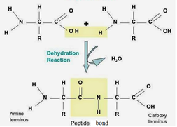
Structure of proteins. Peptides.
The peptide is formed by means of interaction of a carboxyl group of one amino acid and amino group of other amino acid.
A peptide consists of two or more amino acid residues linked by peptide bonds.
Peptides of more thenten amino acid residues are termed polypeptides.

Slide 6
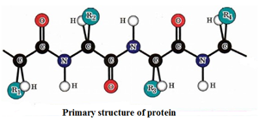
Primary structure
Primary structure of protein molecules is the sequence of amino acid residues in the polypeptide chain including all the covalent bonds between amino acids.
Primary structure becomes stable due to the peptide bonds.

Slide 7
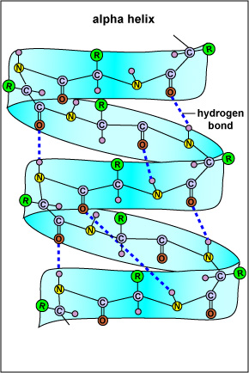
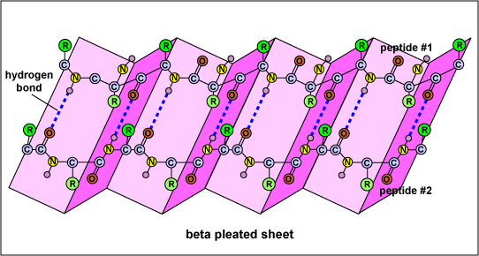
Secondary structure
Secondary structure of a protein is the space conformation of the polypeptide chain with making more often α-helix or β-conformation.
The types of secondary structure are α-helix or β-conformation.

Slide 8
Tertiary structure
Tertiary structure is the method of installation of the polypeptide chain in three-dimensional space.
The tertiary structure is stabilized by connections between the side radicals of amino acids.
These include a covalent bond (disulfide) and noncovalent (hydrogen, ionic bonds and hydrophobic interactions).

Slide 9
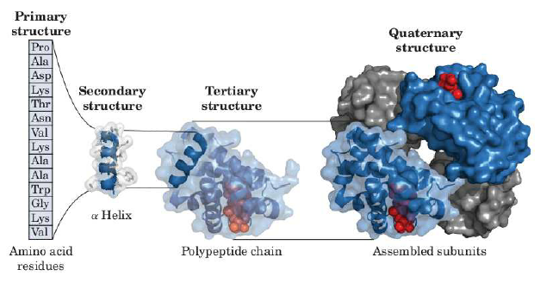
Quaternary structure
Quaternary structure is an organization of several polypeptide chains, each of which has tertiary structure, combined into a single functional protein molecule.

Slide 10
Quaternary structure
Protomer is a separate polypeptide chain in the tertiary structure, which does not perform the function of a protein.
Subunit is a protomer or compounds of several protomers able to perform some of the functions of the protein.
The oligomer (multimer) is a combination of protomers or subunits in the quaternary structure of the protein carrying the full functional activity of the protein.
Quaternary structure is stabilized by non-covalent bonds between protomers (hydrogen, electrostatic, hydrophobic interactions).

Slide 11
Physical and chemical properties of proteins
The amphoteric nature of proteins
The solubility
The ability of precipitation

Slide 12
The amphoteric nature of proteins
Proteins are composed of radicals of lysine, arginine, histidine, glutamic and aspartic acids, containing functional groups, capable of ionization.
Such groups are called ionogenic groups.
Proteins have acidic and basic properties due to carboxyl and amino groups.
Total charge of a protein molecule depends on the ratio of ionized anionic radicals of glutamine and asparagine and cation radicals of arginine, lysine, and histidine.
Isoelectric point (pI) of proteins is value of pH, when total charge of protein is equal to naught.
Isoelectric point is determined by number of amino and carboxyl groups in a protein molecule.

Slide 13
If amount of amino and carboxyl groups is equal, pI lies in weakly acidic environment, ionization of carboxyl groups is slightly higher, than amino groups.
If amount of NH₂>СООН groups, then pI lies in alkaline environment.
If amount of NH₂<СООН groups, then pI is acidic environment.
In case pH >pI the protein charge is always negative, because carboxyl groups are transferred in the form of carboxyl anion, and amino groups are transferred in the neutral form.
When pH < pI the protein charge is positive, because when value of pH decreases, more amino groups proceeds in the form of cation (of positive charge amino group) and the dissociation of carboxyl groups is suppressed.

Slide 14
The solubility
Proteins form colloidal solutions.
Proteins, with total positive or negative charge, are more soluble, than proteins, which are in the isoelectric point.
Total charge increases the number of dipoles of water, capable of contacting with a protein molecule and prevents the contact likely charged molecules, as a result the solubility of proteins increases.
Thus, there are two factors of proteins stability in the solution:
The existence of a hydrated shell.
The secondary. The existence of charge.

Slide 15
The ability of precipitation.
The protein precipitation can be reversible – salting-out and irreversible – denaturation.
Salting-out.
The process of precipitating protein from the solution by adding concentrated solution of neutral salts of alkaline or alkaline earth metals is called salting – out.
This process is explained by dehydration of protein molecules by salts that lead to molecular aggregation and precipitation.
Salts of alkaline metals, which are strong electrolytes, dissociate in water into ions and attract the dipoles of water including the surface of proteins.
Proteins lose one of the factors of sustainability – which is hydrated shell.

Slide 16
The denaturation
Denaturation is the destruction of the quaternary, tertiary and partially secondary structure of a protein with preservation of the primary structure that is with the loss of the native structure.
Denaturation is different from the protein hydrolysis because of hydrolysis the primary structure is destroyed to amino acids by breaking peptide bonds.
Agents of denaturation:
Physical agents are heat, pressure, mechanical effect, ultrasonic and ionizing radiation.
Chemical agents are strong acids or alkalis, organic solvents, detergents, reducing agents, concentrated salts, heavy metals. Heavy metals ions cause precipitation of proteins because they form insoluble chelate complexes with a protein molecule which causes its precipitation.
Biological agents are snake venoms, insect venoms, poisons of some plants, toxins of microorganism.

Slide 17
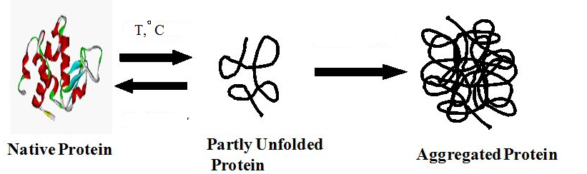
Mechanism of denaturation
During denaturation violation of the native conformation of proteins occurs due to rupture of weak bonds. This ionic, hydrogen, hydrophobic interactions.
During denaturation hydrophobic radicals of amino acids which are in the native proteins in the depth of a molecule appear on the surface this creates the conditions for aggregation.
Aggregates of protein molecules precipitate.
Denaturation is always accompanied by loss of the biological function of a protein.

Slide 18
Properties of the denaturated protein. The renaturation.
Protein precipitates because main factors of resistance such as charge and hydrated shell are lost.
During denaturation the primary structure is not changed, that is that there is no rupture of peptide bonds.
Denaturated proteins are easily digested under the action of digestive enzymes.
They don't move in the electric field.
Along with denaturation there is another process that is renaturation.
Renaturation is restoring the native conformation of protein if the secondary structure isn't destroyed and the effect of denaturing factor was short time.
It is impossible to say that renaturation is the process reverse to denaturation.
Remember denaturation is the irreversible process.

Slide 19
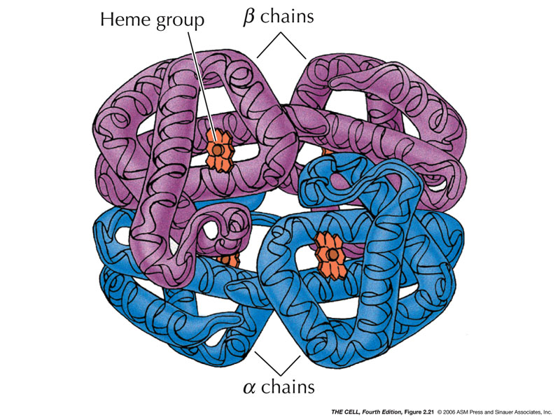
THANK YOU FOR YOUR ATTENTION!

